Slide 1

AI 芯片
— AI 计算体系
比特位&矩阵运算
ZOMI

Slide 2
Talk Overview
AI 计算体系
深度学习计算模式
计算体系与矩阵运算
AI 芯片基础
通用处理器 CPU
从数据看 CPU 计算
通用图形处理器 GPU
AI专用处理器 NPU/TPU
计算体系架构的黄金10年

Slide 3
Talk Overview
AI 计算体系与矩阵运算
Key Metrics – AI芯片关键指标
Matrix Multiplication – 矩阵运算
Bit Width – 比特位数
Specialized Hardware – 专用硬件

Slide 4
矩阵运算

Slide 5
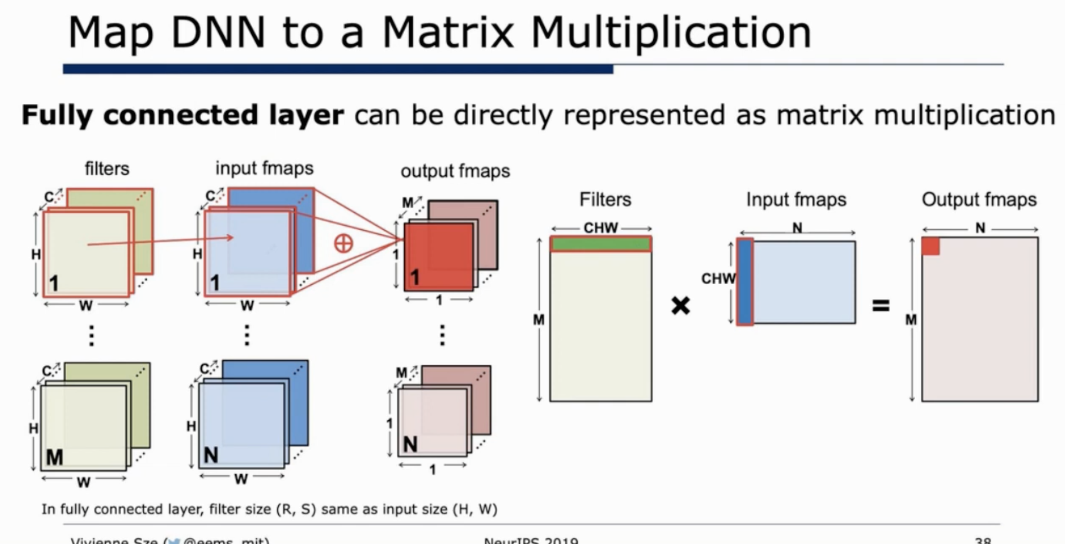

Slide 6
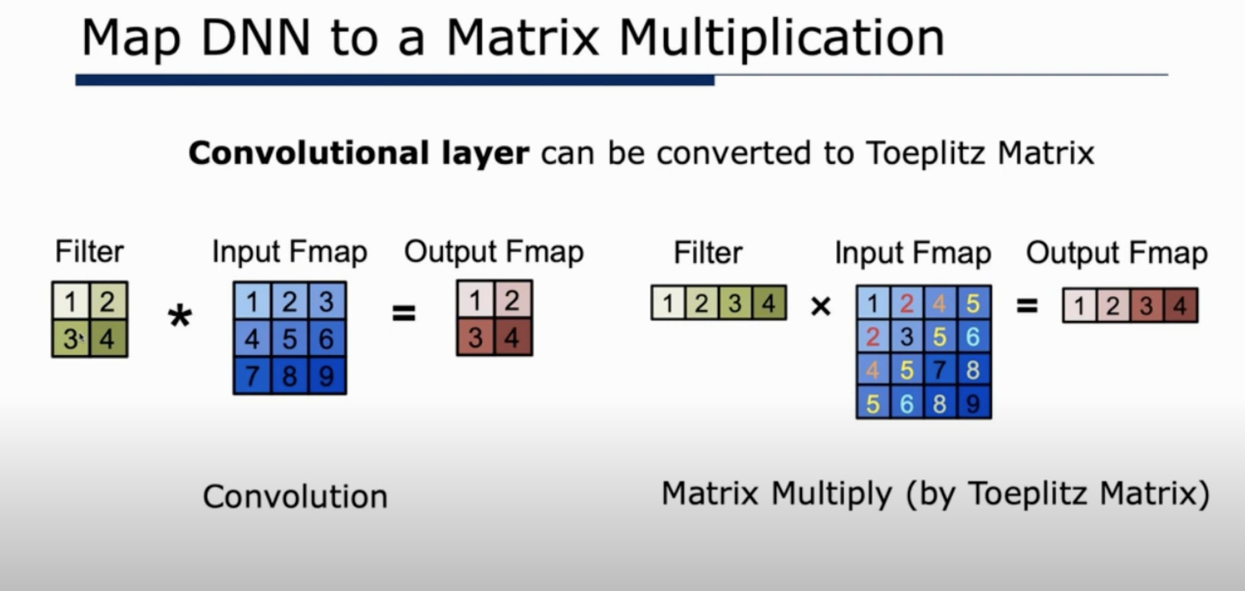

Slide 7
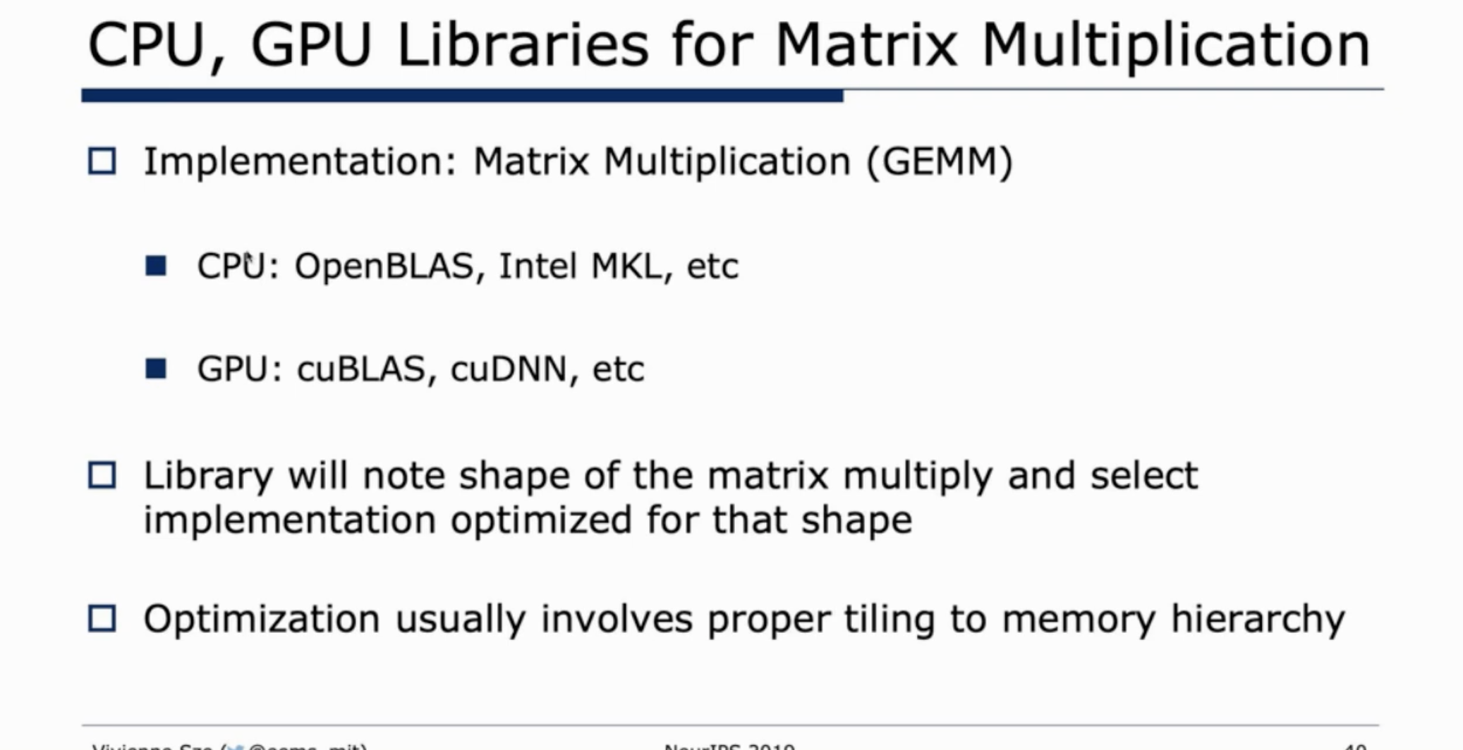

Slide 8
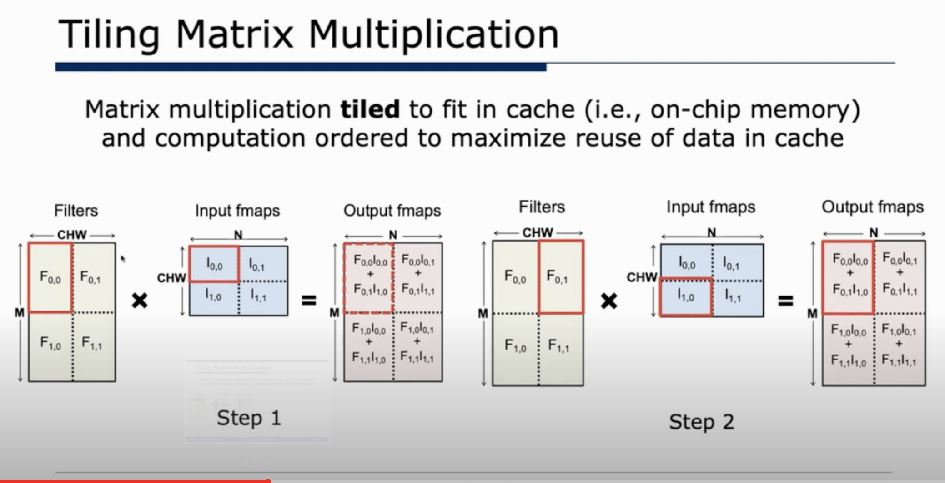

Slide 9
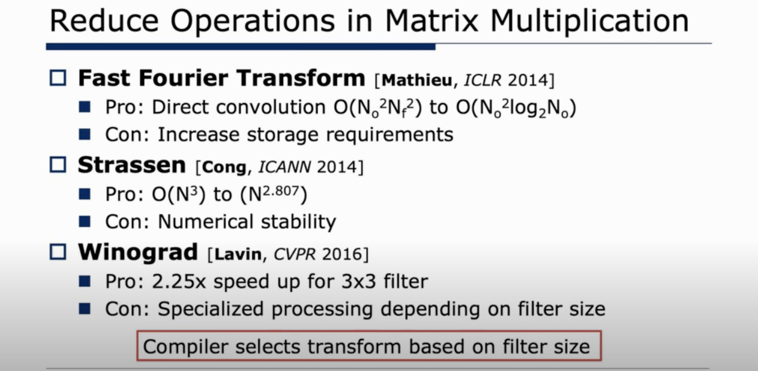

Slide 10
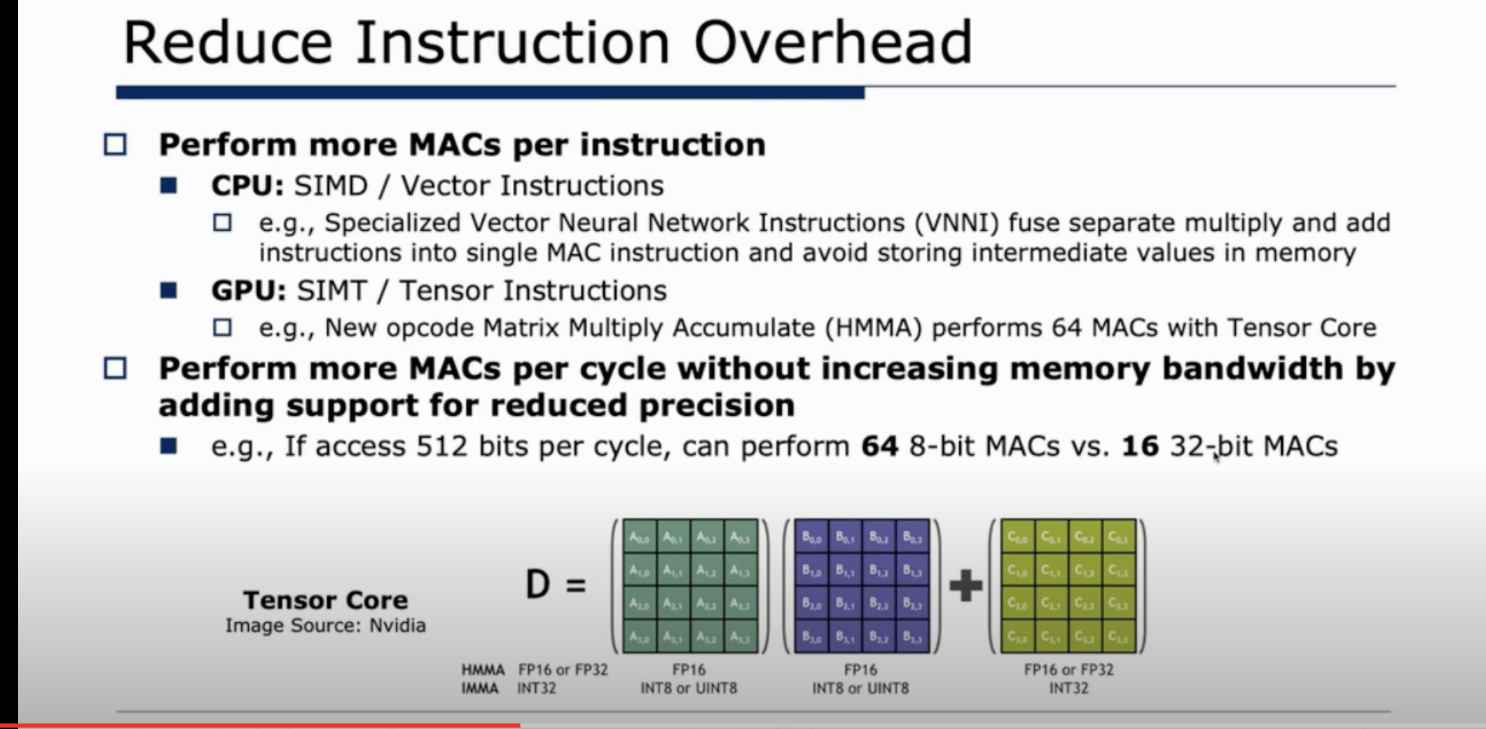

Slide 11
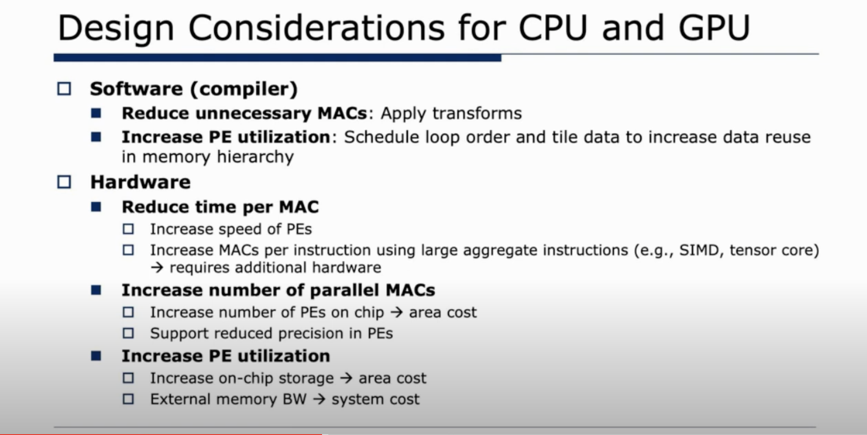

Slide 12
比特位数 Bits Width

Slide 13
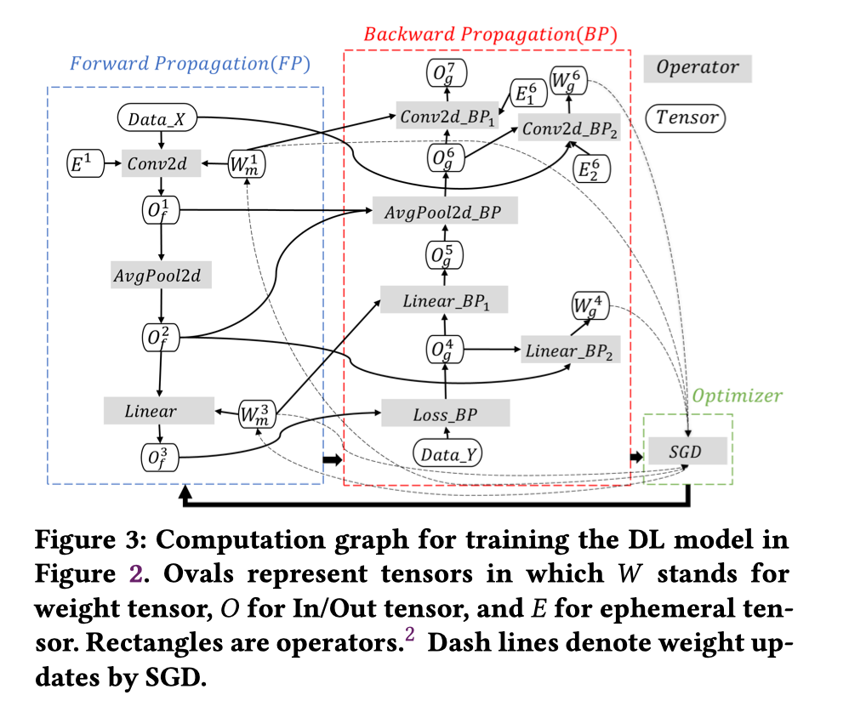
什么决定比特位宽 Bit Width ?
在AI流程里，不同数据会使用不同类型格式，才能保证精度达标。
训练 Training: weights, activation, partial sums, gradients and weight update.
推理 Inference: weights, activations, partial sums
（所需的精度可能因数据类型而异 ）

Slide 14
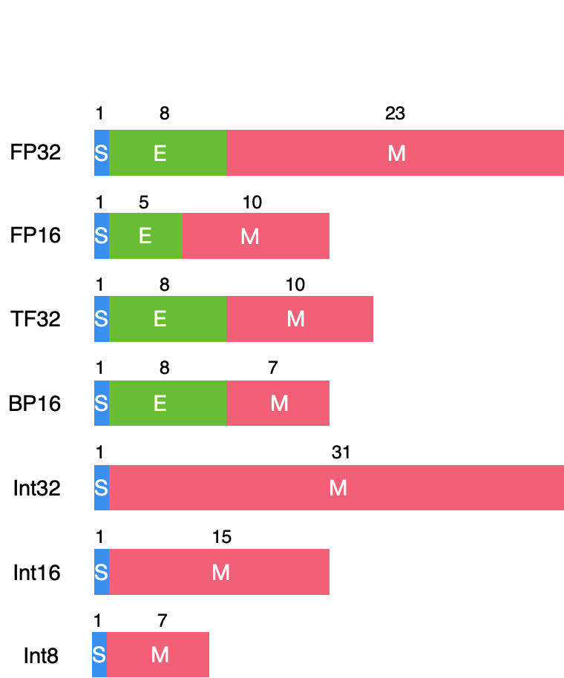
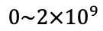
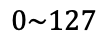
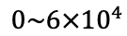
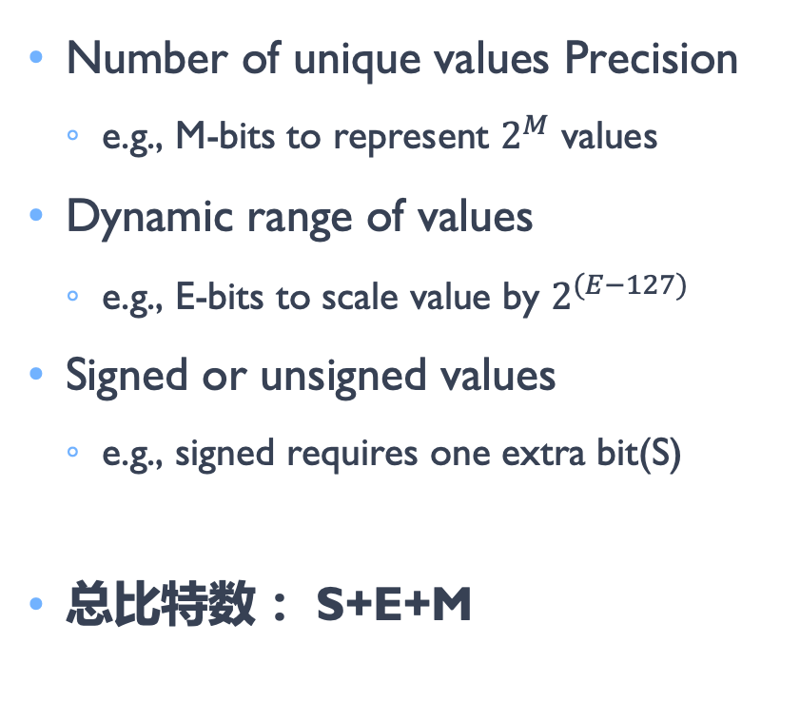
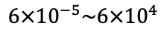
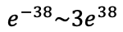
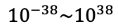
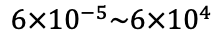
什么决定比特位宽 Bit Width ?
Range
Number of unique values Precision
e.g., M-bits to represent $2^{M}$ values
Dynamic range of values
e.g., E-bits to scale value by $2^{(E−127)}$
Signed or unsigned values
e.g., signed requires one extra bit(S)
总比特数： S+E+M
$${10}^{−38}\sim {10}^{38}$$
$$6×{10}^{−5}\sim {6×10}^{4}$$
$$6×{10}^{−5}\sim {6×10}^{4}$$
$$e^{−38}\sim {3e}^{38}$$
$$0\sim {2×10}^{9}$$
$$0\sim {6×10}^{4}$$
$$0\sim 127$$

Slide 15
什么决定比特位宽 Bit Width ?
Range
Floating Point(FP) allows range to change for each value(E-bits)
Fixed Point(Int) has fixed range
CPU 或者 GPU 默认采用 FP32
$${10}^{−38}\sim {10}^{38}$$
$$6×{10}^{−5}\sim {6×10}^{4}$$
$$6×{10}^{−5}\sim {6×10}^{4}$$
$$e^{−38}\sim {3e}^{38}$$
$$0\sim {2×10}^{9}$$
$$0\sim {6×10}^{4}$$
$$0\sim 127$$

Slide 16
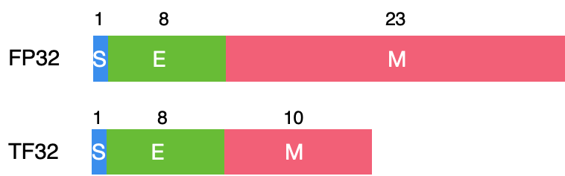
AI 芯片设计的思考
Reduce number of unique values – Precision(M-bits)
Default: Uniform quantization (values are equally spaced out)
None-uniform quantization (spacing can be computed)
Fewer unique values can make transforms and compression more effective
Reduce dynamic range(E-bits)
If Possible, fix range (used fixed point)
Share range across group of values (weights for a layer or channel)
Tradeoff between number of bits allocated to M-bits and E-bits
S=1, E=5, M=10, Total bits=32
S=1, E=8, M=7, Total bits=19

Slide 17
硬件优化方案

Slide 18


Slide 19
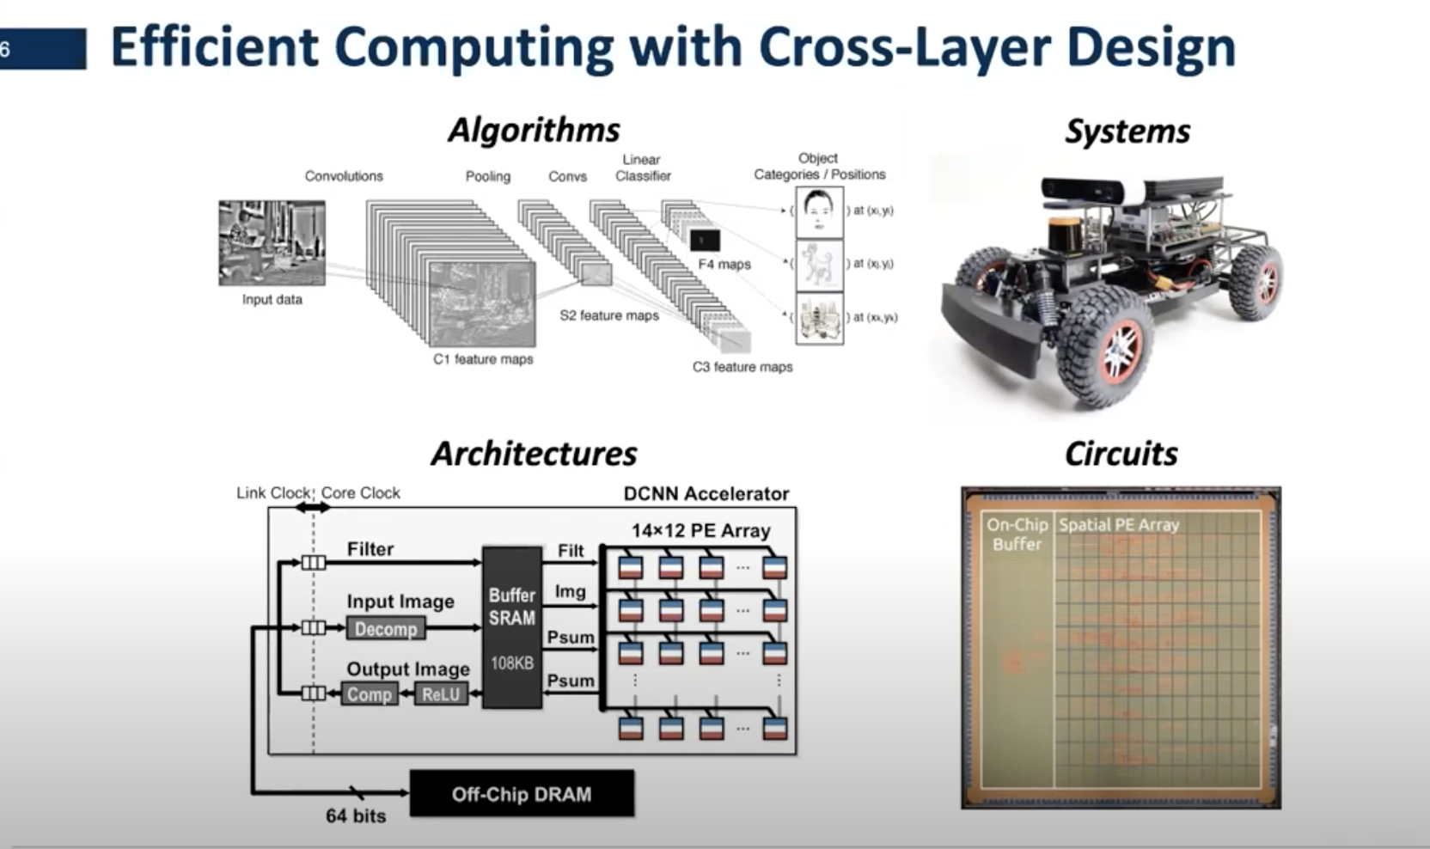
CPU 发展历史和组成

Slide 20
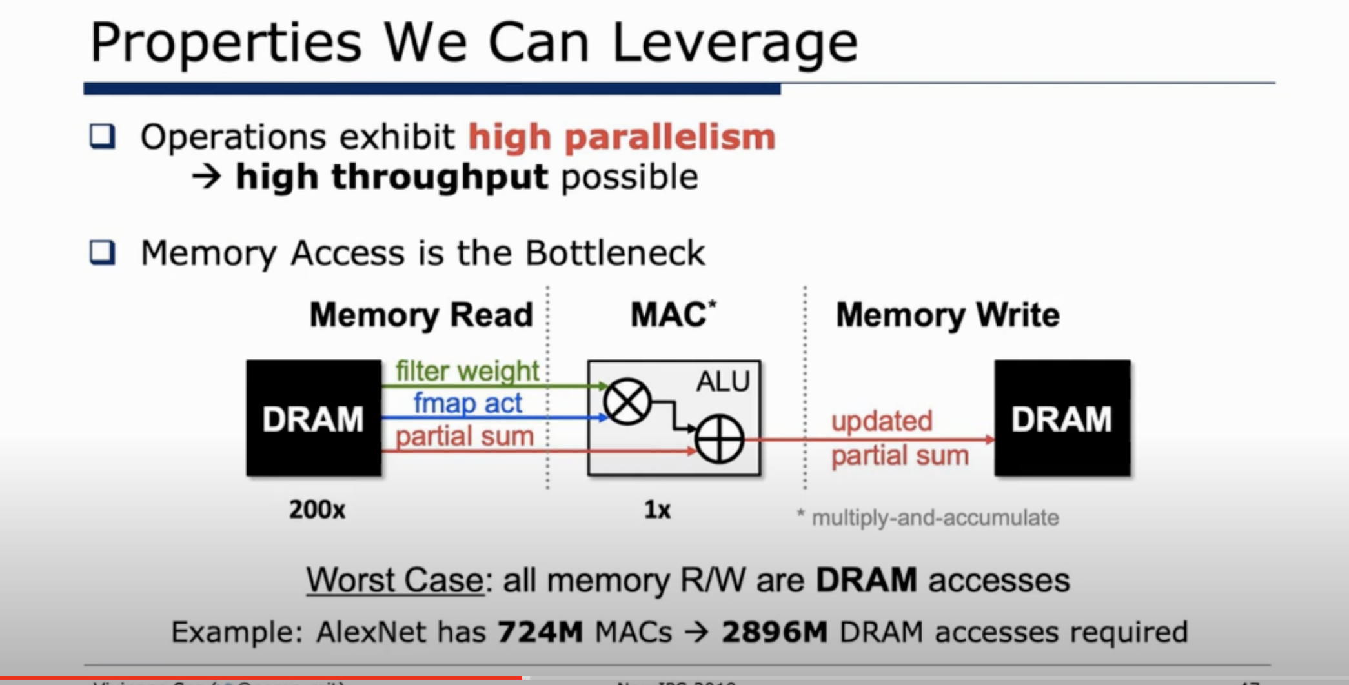

Slide 21
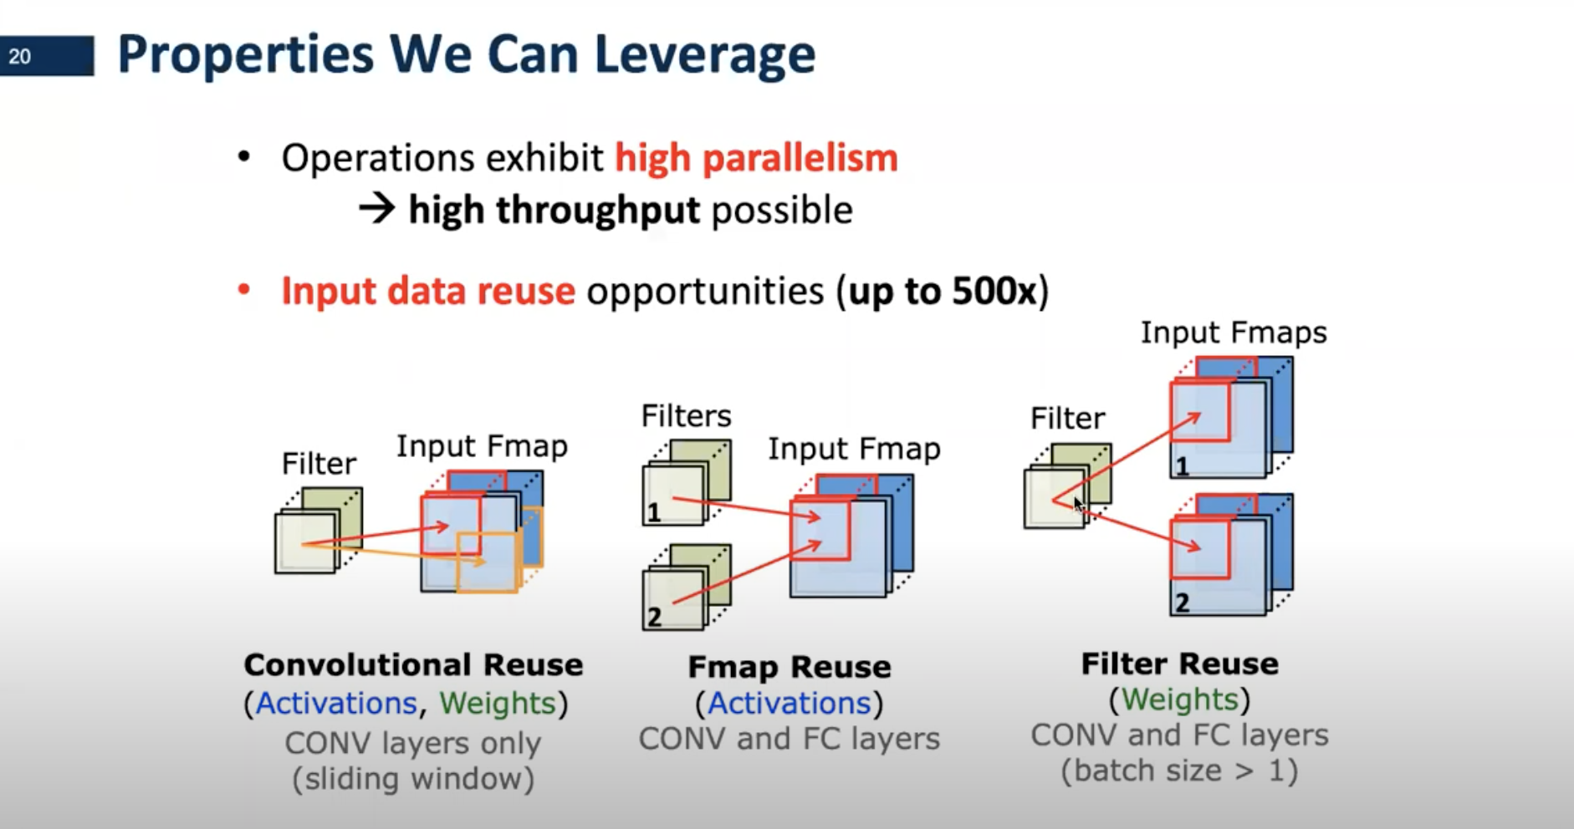
通过对cnn进行分析，看怎么重用相关数据，减少数据的搬运和读取，从而节省energy

Slide 22
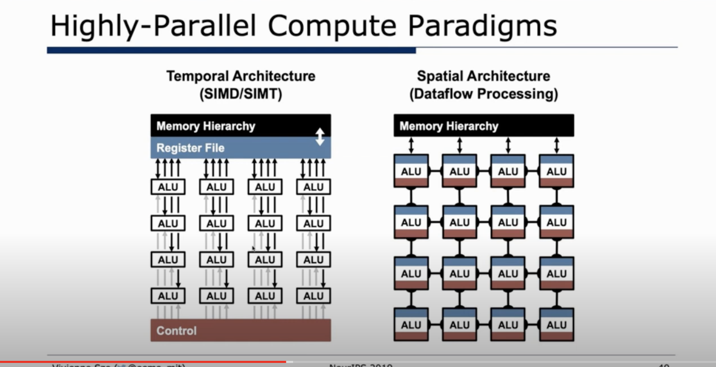

Slide 23
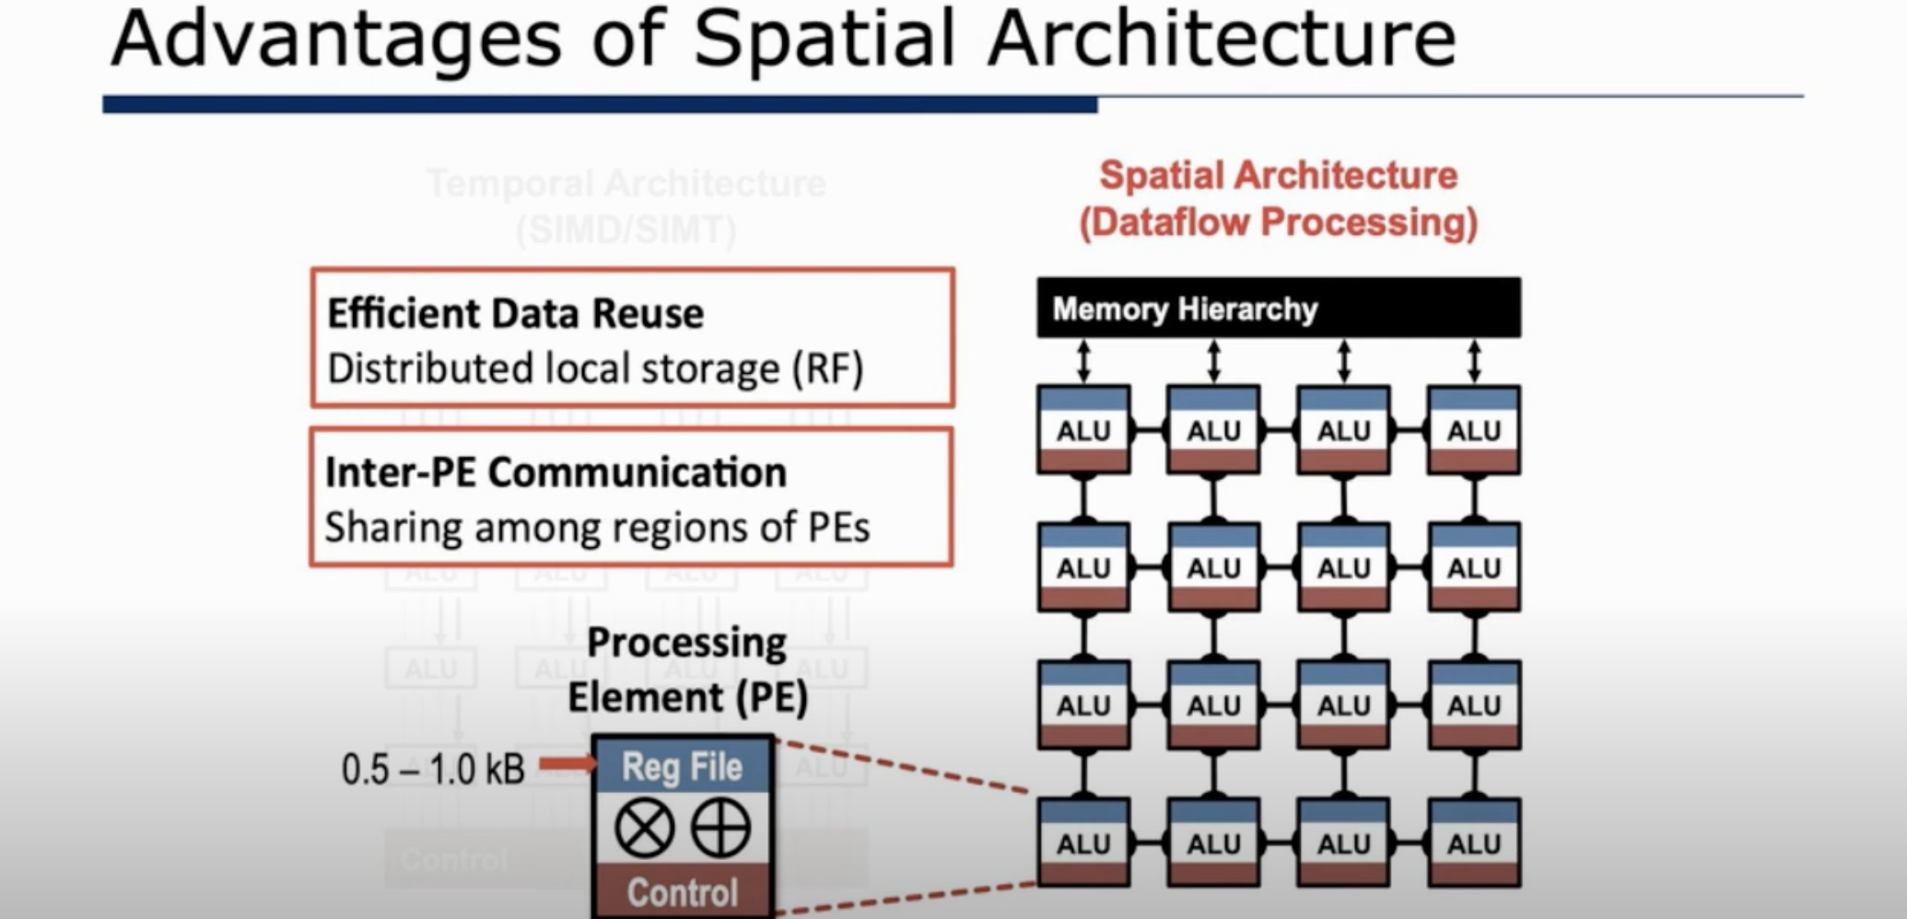

Slide 24
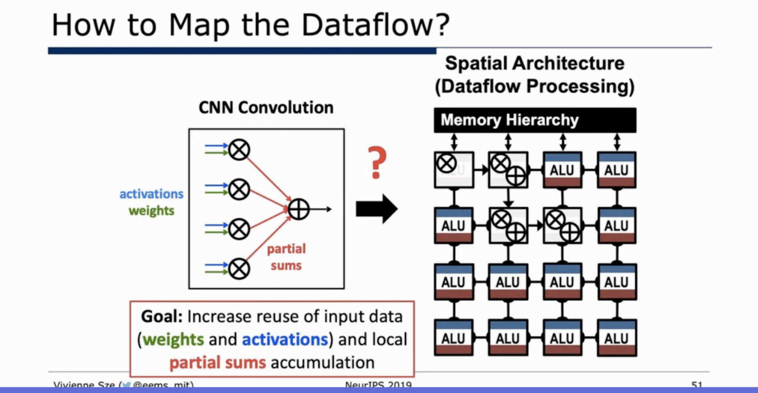

Slide 25
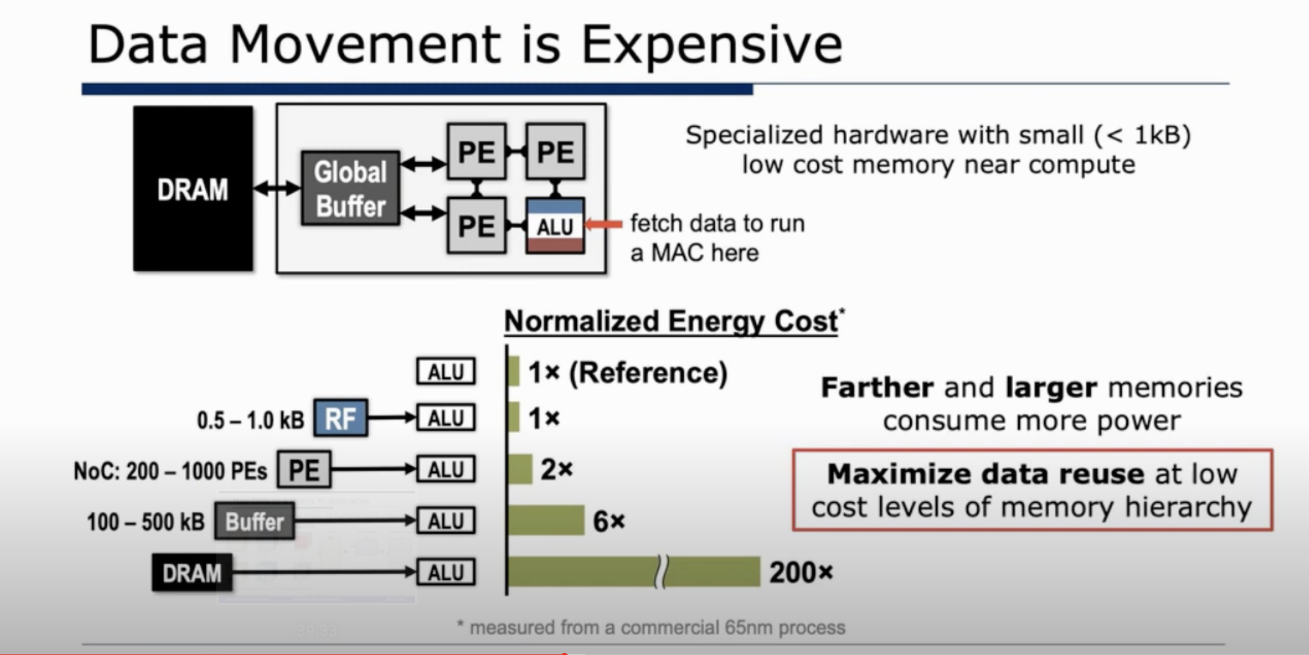

Slide 26
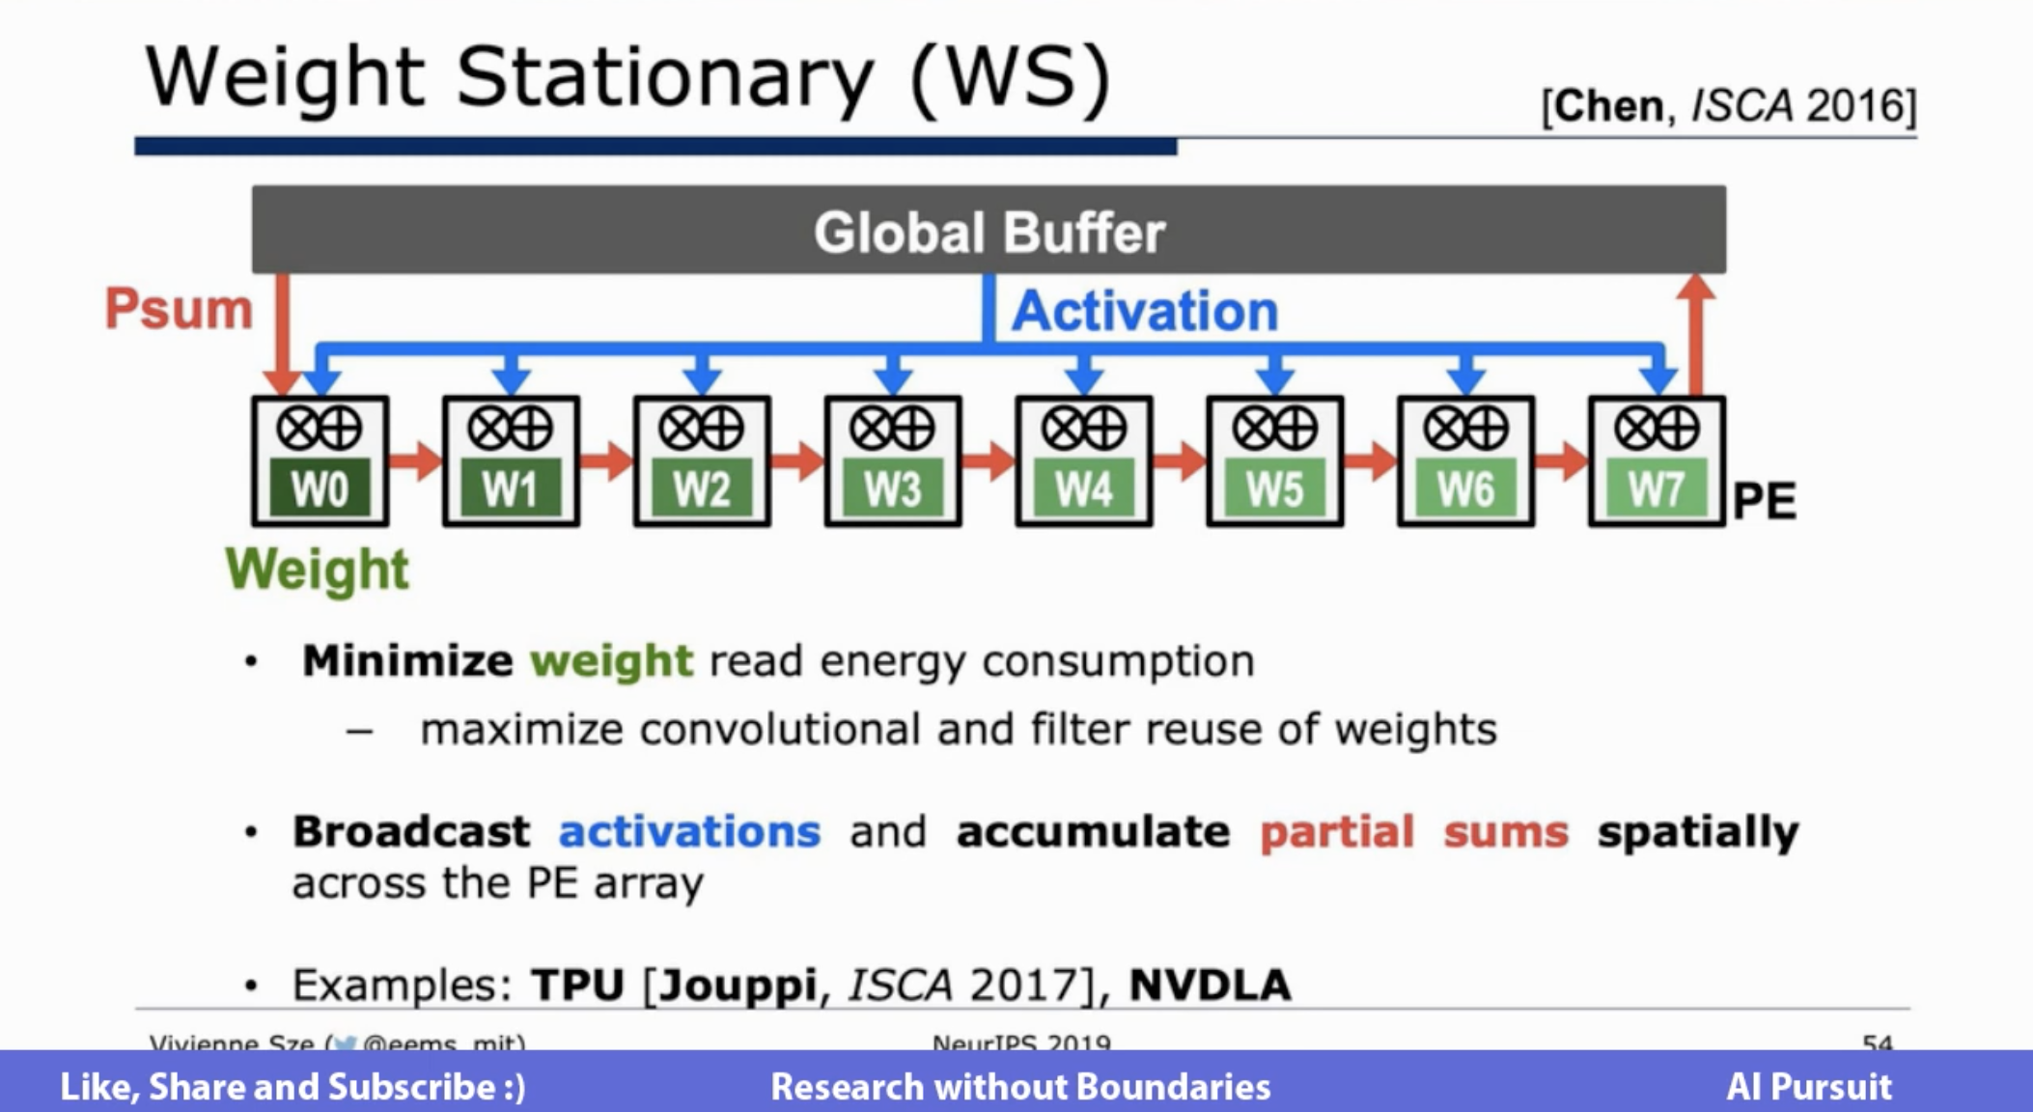

Slide 27
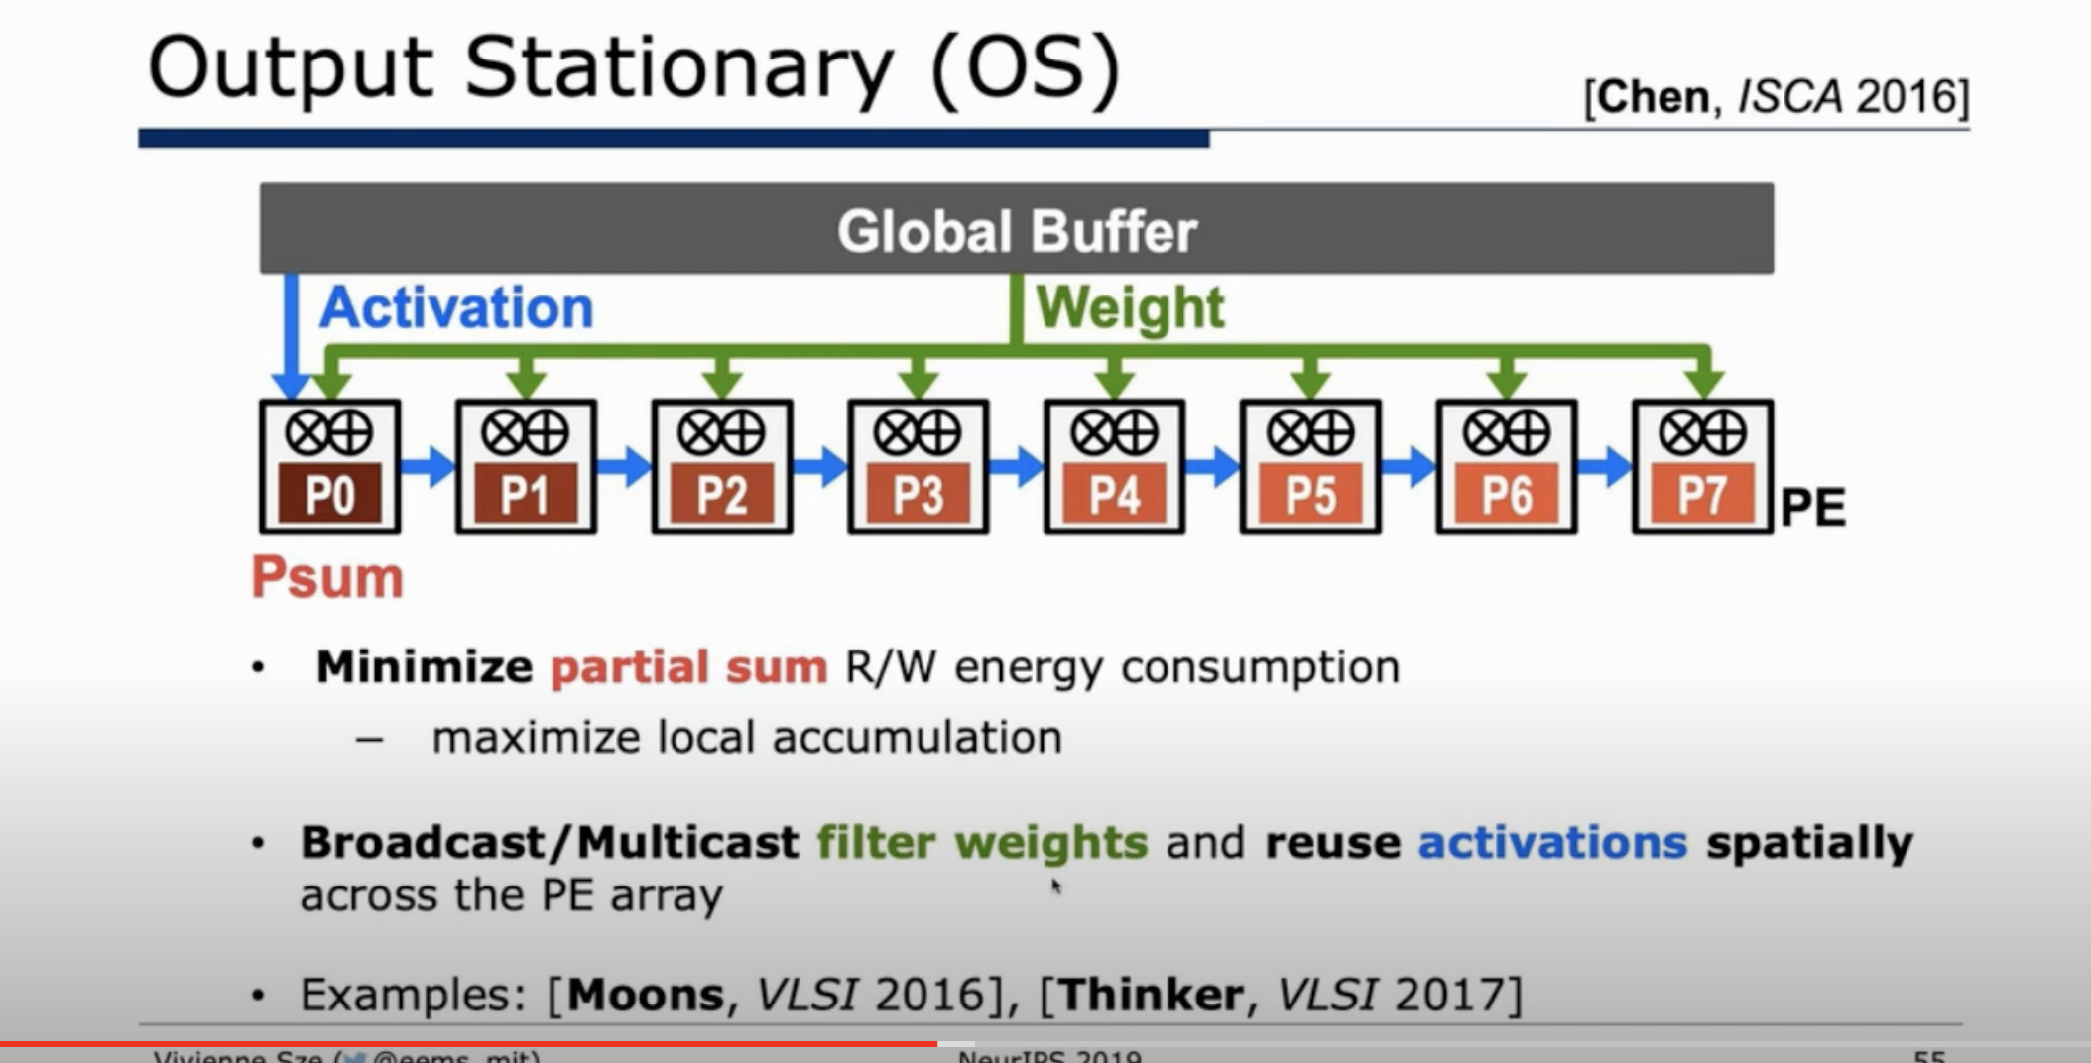

Slide 28
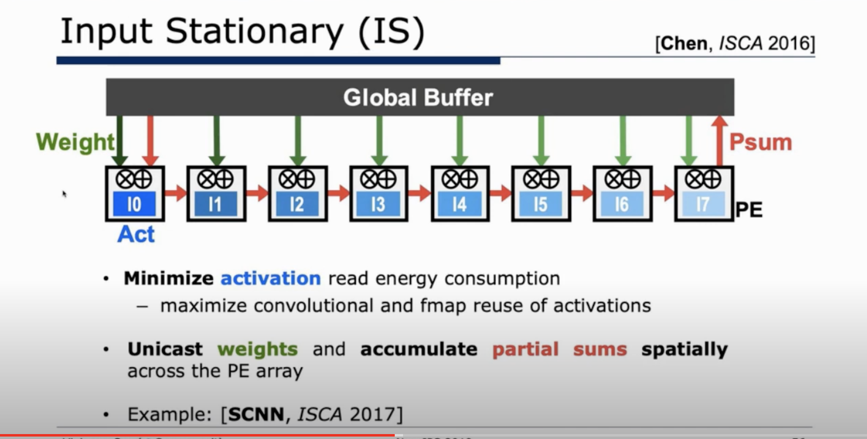

Slide 29
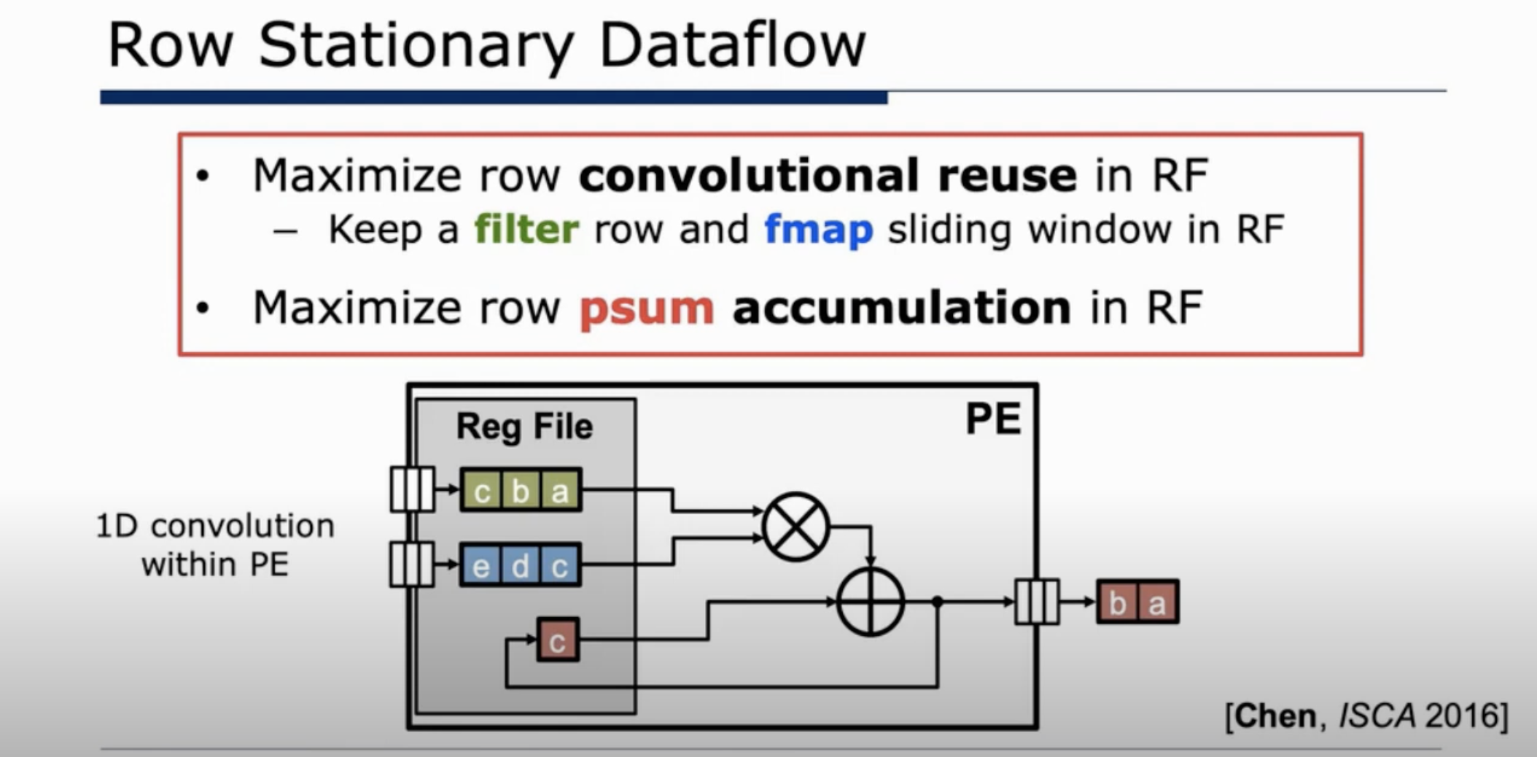

Slide 30
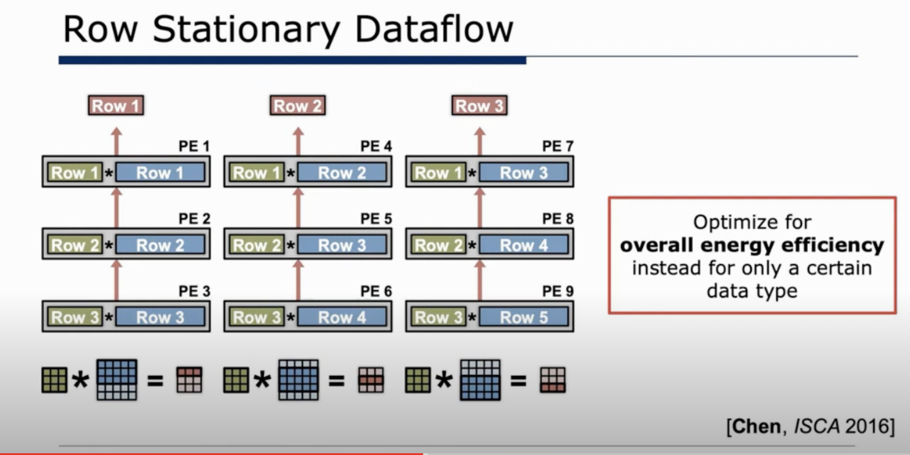

Slide 31
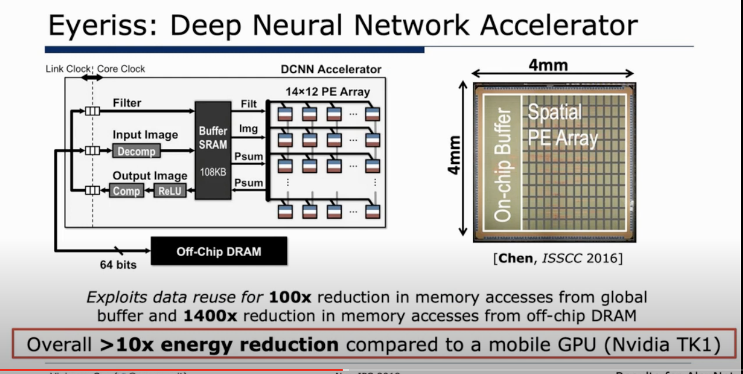

Slide 32
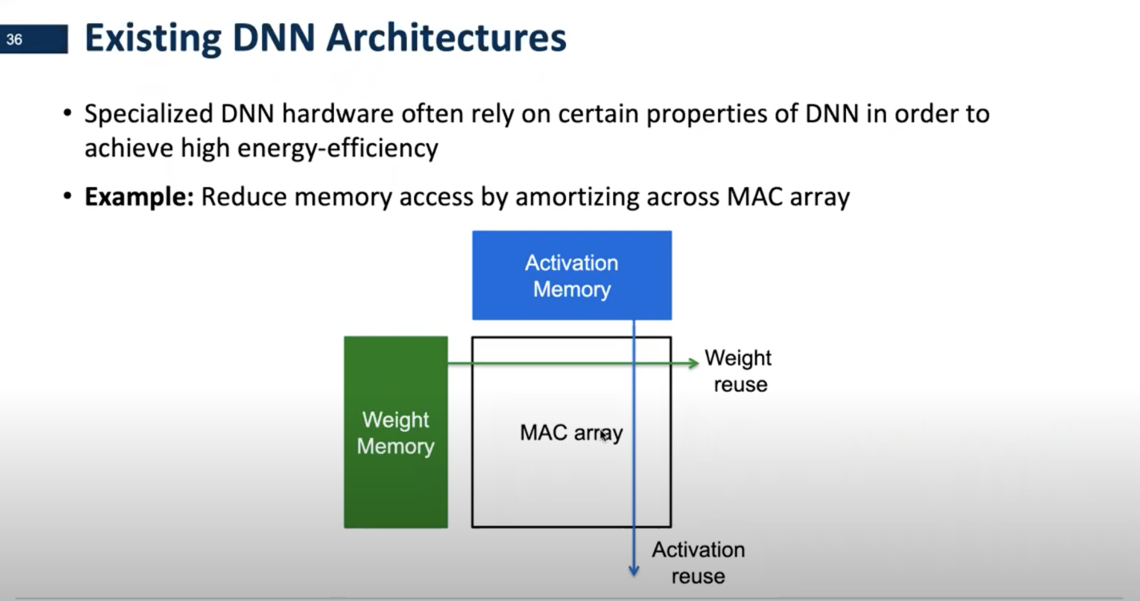

Slide 33
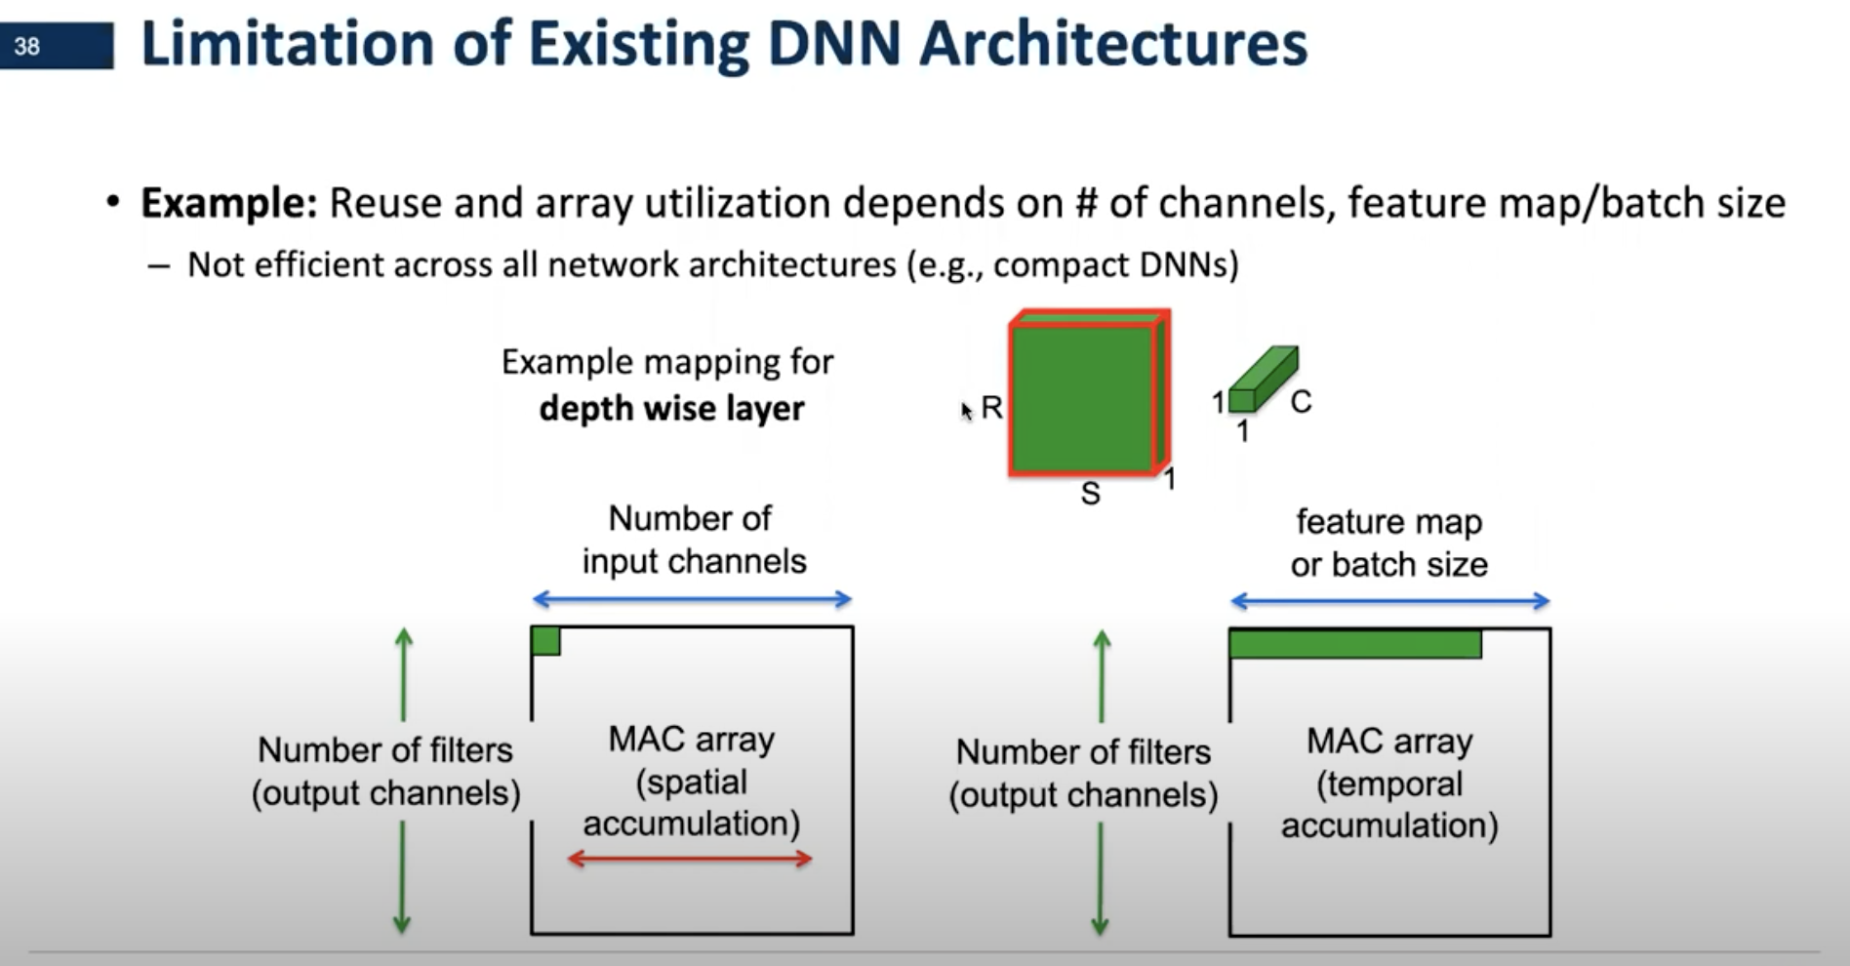
v

Slide 34
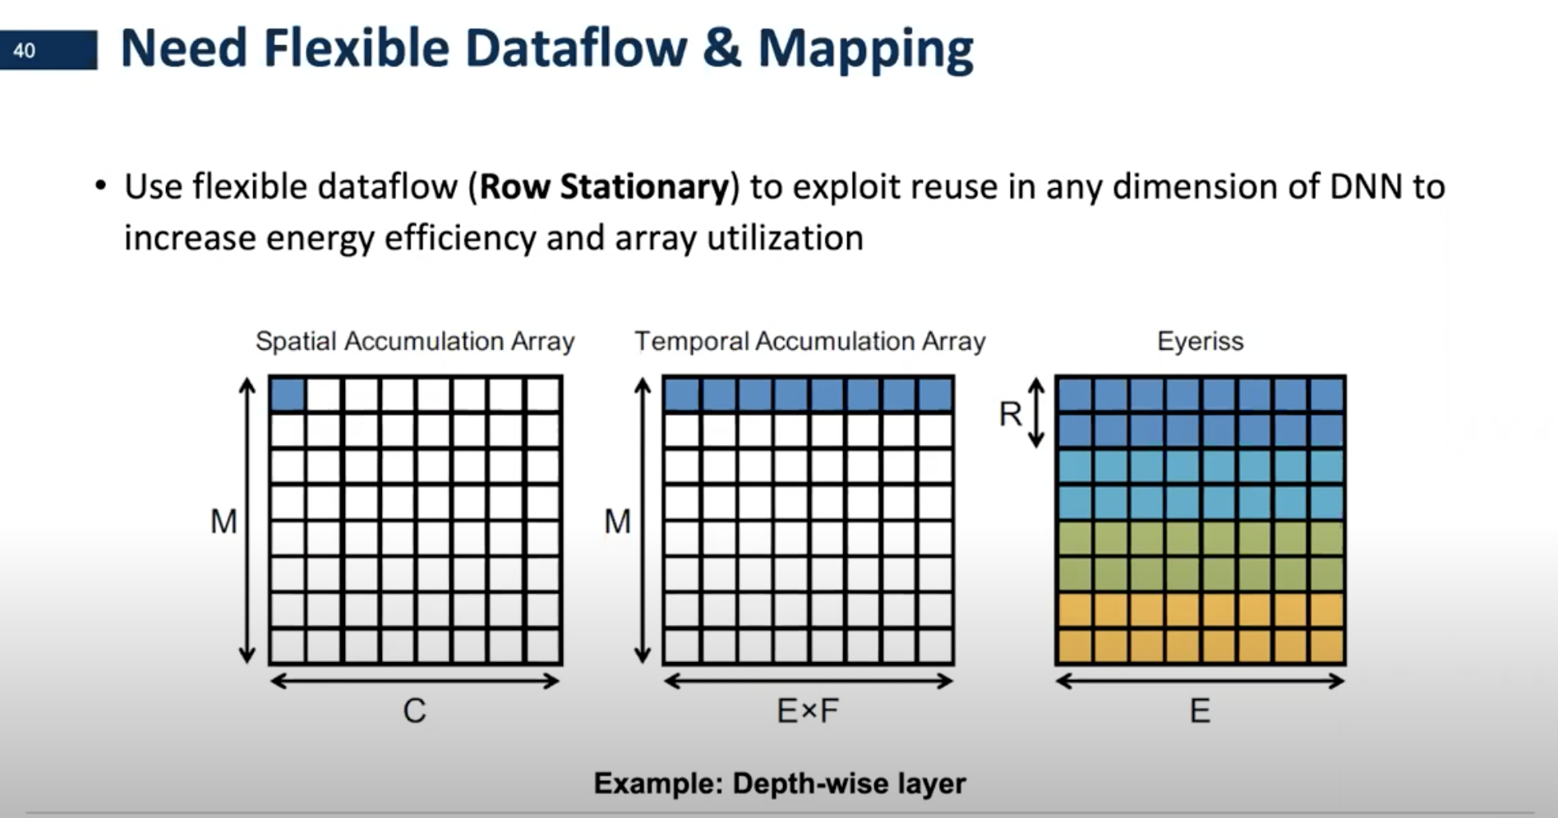

Slide 35
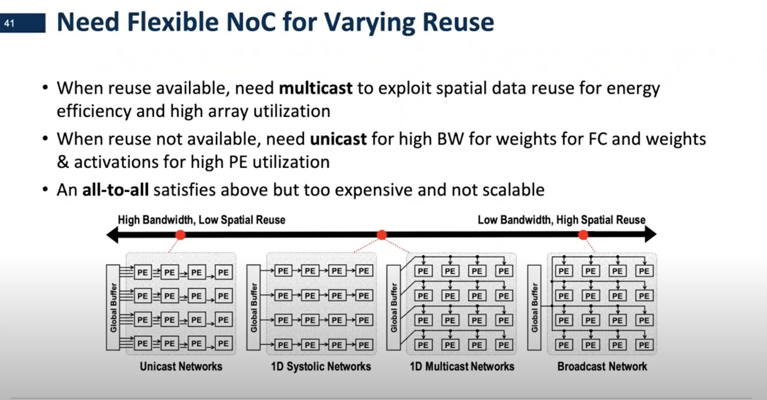

Slide 36
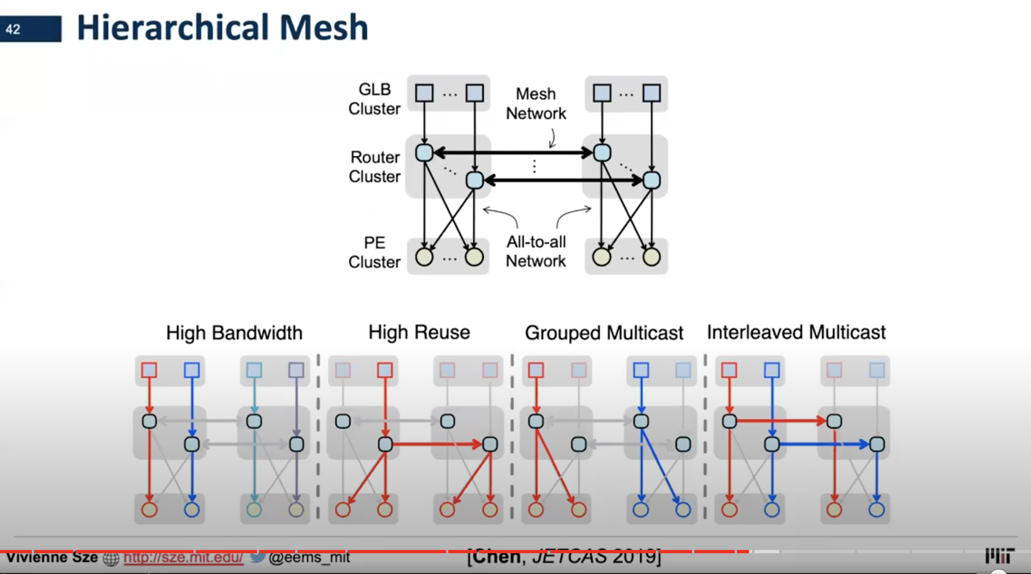

Slide 37
引用

Slide 38
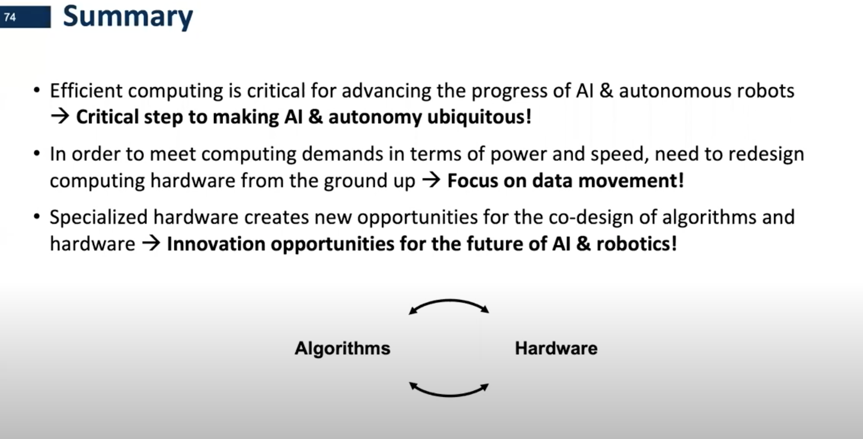
Summary

Slide 39
Notes:
39

